Slide 1
M08 - Test Report
Team FEED DEAD BEEF

Slide 2
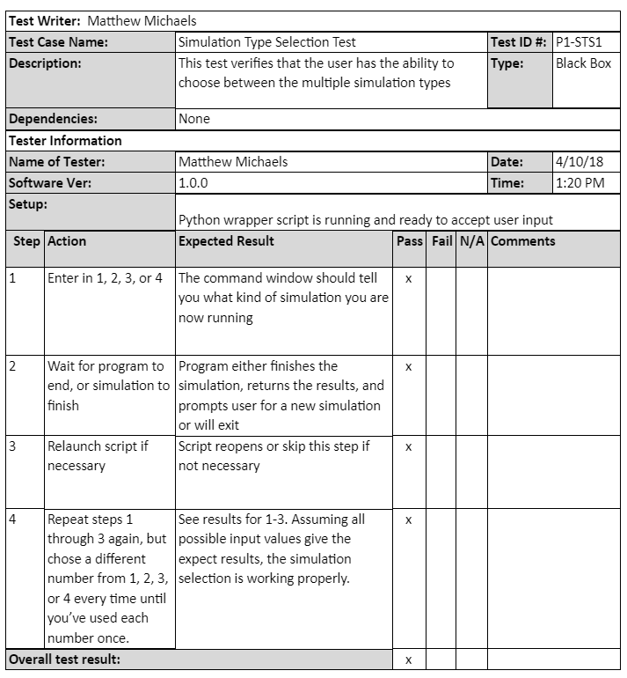

Slide 3
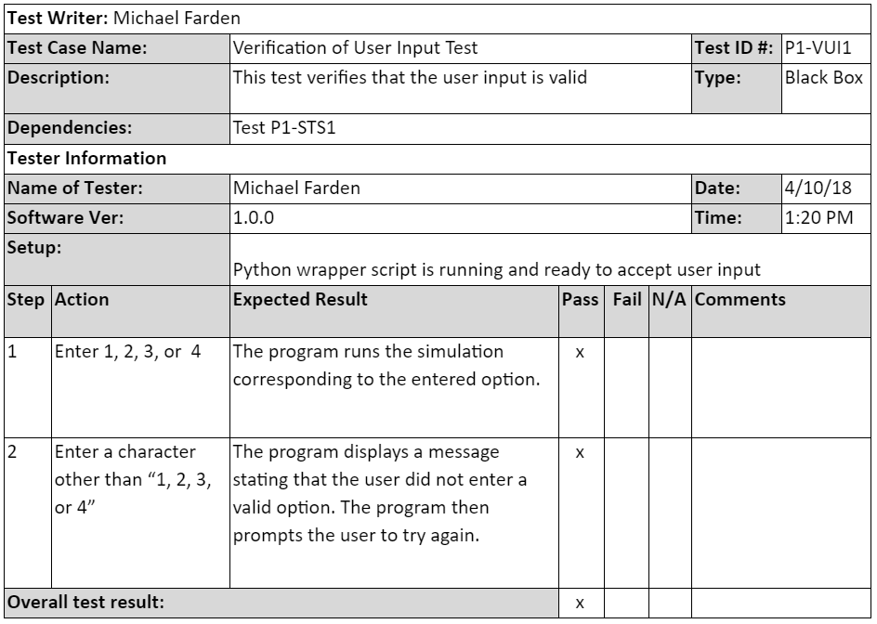

Slide 4
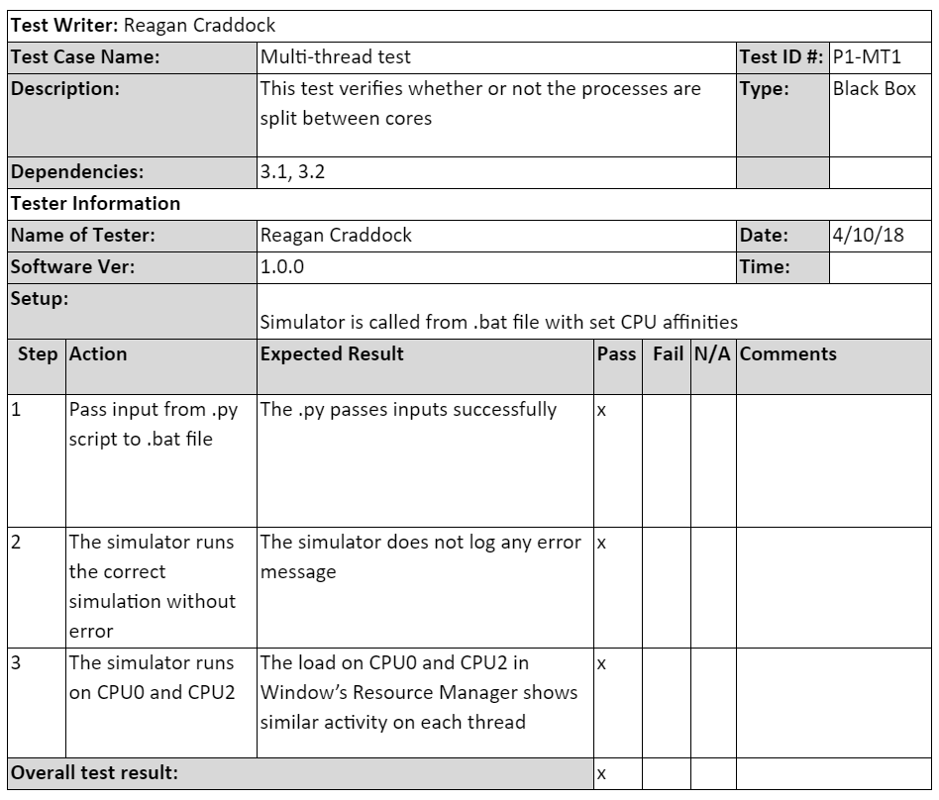

Slide 5
